Slide 1
Compiler Design
23CS5PECPD – Unit 3
Prof. SNEHA S BAGALKOT
Assistant Professor, Dept. of CSE

Slide 2
UNIT – 3: Syntax-Directed Definitions
Syntax-Directed Definitions,
Evaluation order for SDDs,
Applications of Syntax-directed translation,
Syntax-directed translation schemes.

Slide 3
Introduction
This chapter develops the theme: translation of languages guided by context-free grammar.
We associate information with a language construct by attaching attributes to the grammar symbol(s) representing the construct.
A syntax-directed definition [SDD] specifies the values of attributes by associating semantic rules with the grammar productions.
  For example, in an infix-to-postfix translator
  E → E1 + T E.code = E1.code || T.code || ‘+’
Syntax-Directed Translation

Slide 4
Introduction
A syntax-directed translation [SDT] scheme embeds program fragments called semantic actions within production bodies, as in
  E → E1 + T {print ‘+’}
SDDs can be more readable, and hence more useful for specifications.
SD translation scheme can be more efficient, thus more useful for implementations.
L-attributes translations [ L => Left-to-right]
S-attributed translations [ S => synthesized]
Syntax-Directed Translation

Slide 5
Syntax-Directed Definitions
A SDD is a context-free grammar together with attributes and rules.
Attributes -> Grammar symbols
Rules -> Productions
Attributes may be of any kind:
  Numbers, types, table references, or strings, for instance.
If X is a symbol and a is one of its attributes, then we write “X.a” to denote the value of a at a particular parse-tree node labelled X.
Syntax-Directed Translation

Slide 6
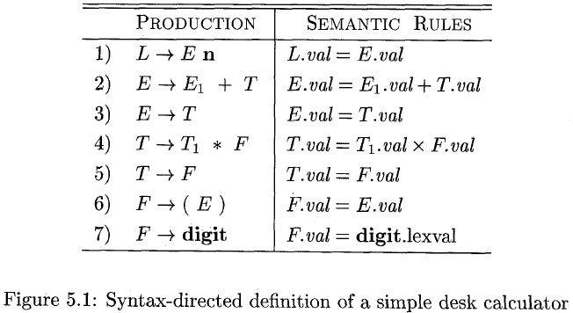
Inherited and Synthesized Attributes
Two kinds of attributes for nonterminals:
  A synthesized attribute for a nonterminal A at a parse-tree node N is defined by a semantic rule associated with the production at N.
  A inherited attribute for a nonterminal B at a parse-tree node N is defined by a semantic rule associated with the production at the parent of N.
Example 5.1:
Arithmetic expressions:
E -> E₁ + T
E -> T
T -> T₁ * F
T -> F
F -> (E)
F -> digit
Syntax-Directed Translation

Slide 7
Inherited and Synthesized Attributes
An SDD that involves only synthesized attributes is called S-attributed; the SDD in Fig. 5.1 has this property.
Limited side effects
An S-attributed SDD can be implemented naturally in conjunction with an LR parser.
An SDD without side effect is sometimes called an attribute grammar.
Synthesized attribute : Children of N and N itself.
Inherited attribute : N’s parent, N itself and N’s siblings.
Syntax-Directed Translation

Slide 8
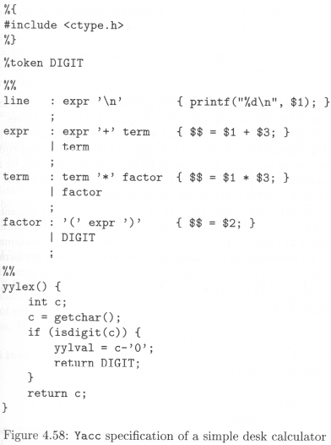
Syntax-Directed Translation

Slide 9
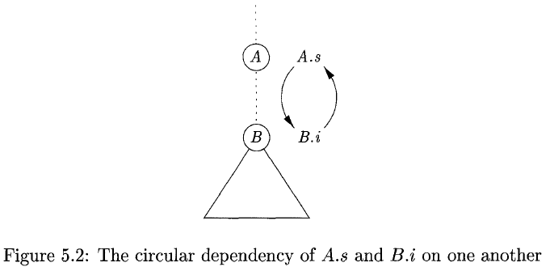

Evaluating an SDD at the Nodes of a Parse Tree
Imagine that the rules of an SDD are applied by first constructing a parse tree and then using the rules to evaluate all of the attributes at each of the nodes of the parse tree (annotated parse tree).
  How do we construct an annotated parse tree?
  In what order do we evaluate attributes?
  Before we can evaluate an attribute at a node of a parse tree, we must evaluate all the attributes upon which its value depends.

Slide 10
Evaluating an SDD at the Nodes of a Parse Tree
With synthesized attributes, we can evaluate attributes in any bottom-up order, such as that of a postorder traversal of the parse tree.
For SDD with both inherited and synthesized attributes, there is no guarantee that there is even one order in which to evaluate attributes at nodes.

Slide 11
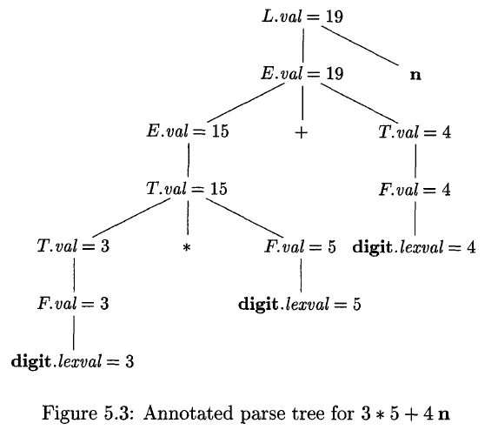
Evaluating an SDD at the Nodes of a Parse Tree
Example 5.2:- 3 * 5 + 4
L -> E n
E -> E + T | T
T -> T * F | F
F -> ( E ) | digit
RMD:
L -> E
-> E + T
-> E + F
-> E + digit
-> T + digit
-> T * F + digit
-> T * digit + digit
-> F * digit + digit
-> digit * digit + digit
-> 3 * 5 + 4
Syntax-Directed Translation

Slide 12
Evaluating an SDD at the Nodes of a Parse Tree
For the SDD of simple desk calculator [fig 5.1] , give annotated parse trees for the following expressions:
i. 8 + 2 * 6 n
ii. ( 3 + 4 ) * ( 5 + 6 ) n
iii. 1 * 2 * 3 * ( 4 + 5 ) n
iv. ( 9 + 8 * ( 7 + 6 ) + 5 ) * 4 n
Syntax-Directed Translation

Slide 13
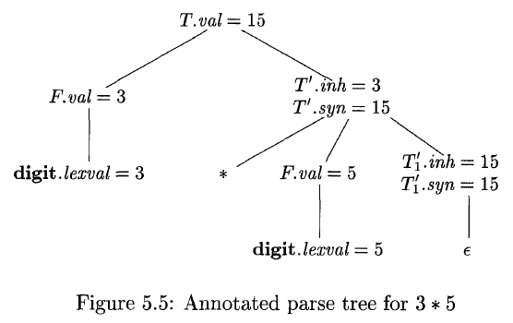
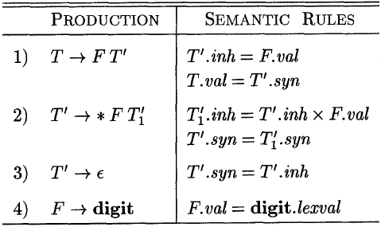
Evaluating an SDD at the Nodes of a Parse Tree
Example 5.3: Non-left Recursive Grammar
E -> T E’
E’ -> + T E’ | Ɛ
T -> F T’
T’ -> * F T’ | Ɛ
F -> ( E ) | digit
Syn: Parent node gets value from child node
Inh: Child gets value from parent or sibling nodes
Fig. 5.4: An SDD based on a grammar suitable for top-down parsing.
Syntax-Directed Translation

Slide 14
Evaluation Orders for SDD’s
“Dependency graphs” are a useful tool for determining an evaluation order for the attribute instances in a given parse tree.
While an annotated parse tree shows the values of attributes, a dependency graph helps us determine how those values can be computed.
We also define two important classes of SDD’s:
  The “S-attributed” and
  the more general “L-attributed” SDD’s.
Syntax-Directed Translation

Slide 15
Dependency Graphs
A dependency graph (DG) depicts the flow of information among the attribute instances in a particular parse tree; an edge from one attribute instance to another means that the value of the first is needed to compute the second.
Edges express constraints implied by the semantic rules.
  For each parse tree node, say a node labeled by grammar symbol X, the DG has a node for each attribute associated with X.
  Suppose that a semantic rule associated with a production p defines the value of synthesized attribute A.b in terms of the value of X.c. Then, the DG has an edge from X.c to A.b.
  Suppose that a semantic rule associated with a production p defines the value of inherited attribute B.c in terms of the value of X.a. Then, the DG has an edge from X.a to B.c.
Syntax-Directed Translation

Slide 16
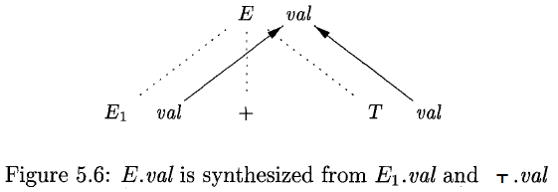
Dependency Graphs
Example 5.4:
  E → E₁ + T E.val = E₁.val + T.val
Syntax-Directed Translation

Slide 17
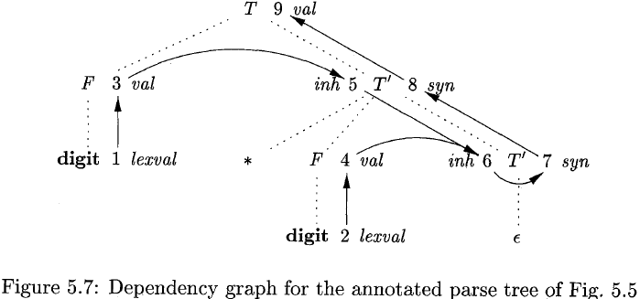
Dependency Graphs
Example 5.5:
Syn: Parent node gets value from child node
Inh: Child gets value from parent or sibling nodes

Slide 18
Ordering the Evaluation of Attributes
The DG characterizes the possible orders in which we can evaluate the attributes at the various nodes for a parse tree.
An ordering embeds a DG into a linear order, and is called topological sort of the graph.
If there is any cycle in the graph, then there are no topological sorts.
If there are no cycles, then there is always at least one topological sort.
Example 5.6:
  Fig. 5.7 has no cycle.
  One topological sort: 1, 2, …, 9
  Another: 1, 3, 5, 2, 4, 6, 7, 8, 9
Syntax-Directed Translation

Slide 19
S-Attributed Definitions
An SDD is S-attributed if every attribute is synthesized.
Example 5.7:
  The SDD of Fig. 5.1 is an example of S-attributed definition.
When an SDD is S-attributed, we can evaluate its attributes in any bottom-up order of the nodes of the parse tree.
postorder(N){
for ( each child C of N, from the left ) postorder(C);
evaluate the attributes associated with node N;
}
S-attributed definitions can be implemented during bottom-up parsing, since a bottom-up parse corresponds to a postorder traversal.
Syntax-Directed Translation

Slide 20
L-Attributed Definitions
An SDD is L-attributed
  Between the attributes associated with a production body, SDG edges can go from left to right, but not from right to left (hence “L-attributed”).
Each attribute must be either
  Synthesized, or
  Inherited, but with the rules limited as follows. Suppose that there is a production A → X₁X₂ … X_{n}, and that there is an inherited attribute X_{i}.a computed by a rule associated with this production. Then the rule may use only:
    Inherited attributes associated with the head A.
    Either inherited or synthesized attributes associated with the occurrence of symbols X₁X₂ … X_{i-1} located to the left of X_{i}.
    Inherited or synthesized attributes associated with this occurrence of X_{i} itself, but only in such a way that there are no cycles in a DG formed by the attributes of this X_{i}.
Syntax-Directed Translation

Slide 21
L-Attributed Definitions
Example 5.8:
  The SDD in Fig. 5.4 is L-attributed.
Example 5.9:
  Any SDD containing the following production and rules cannot be L-attributed.
  A → B C A.s = B.b;
  B.i = f(C.c, A.s)
Syntax-Directed Translation

Slide 22
Semantic Rules with Controlled Side Effects
In practice, translations involve side effects:
  A desk calculator might print a result;
  A code generator might enter type of an identifier into a symbol table.
Attribute grammars have no side effect and allow any evaluation order consistent with the DG.
Translation scheme impose left-to-right evaluation and allow semantic action to contain any program fragment.
Syntax-Directed Translation

Slide 23
Semantic Rules with Controlled Side Effects
We shall control side effects in SDD’s in one of the following ways:
  Permit incidental side effects that do not constrain attribute evaluation.
  Constrain the allowable evaluation orders, so that the same translation is produced for any allowable order.
Example:
  An example of incidental side effect:
  L → E n print(E.val)
Syntax-Directed Translation

Slide 24
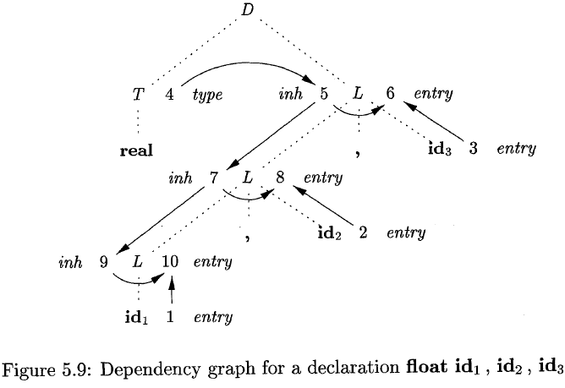
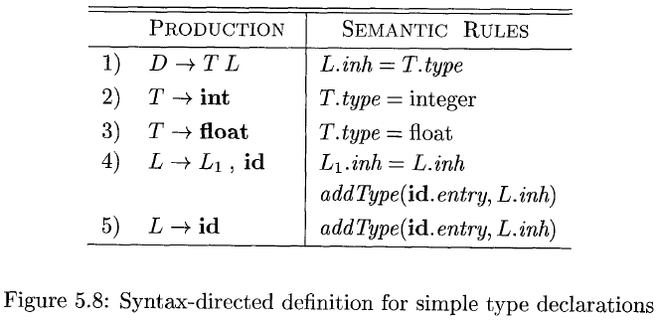
Semantic Rules with Controlled Side Effects
Syntax-Directed Translation

Slide 25
Applications of Syntax-Directed Translation
Construction of syntax trees
Two SDD’s for constructing syntax trees for expressions
  An S-attribute definition, suitable for use during bottom-up parsing
  L-attributed, suitable for use during top-down parsing
Syntax-Directed Translation

Slide 26
Construction of Syntax Trees
A syntax-tree node representing an expression E₁+ E₂ has + and two children representing the subexpressions E₁ and E₂.
Implement the nodes of a syntax tree by objects with suitable number of fields. Each object will have an op field that is the label of the node. The object will have additional fields as follows:
  If the node is a leaf, an additional field holds the lexical value for the leaf.
  If the node is an interior node, there are as many additional fields as the node has children in the syntax tree.
Syntax-Directed Translation

Slide 27
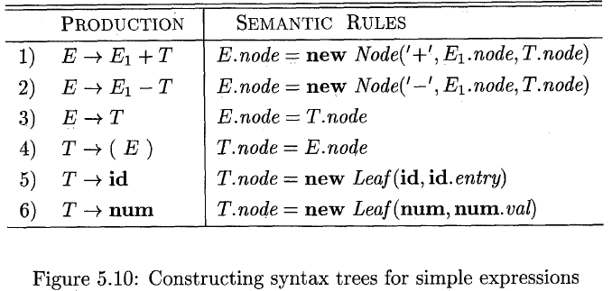
Construction of Syntax Trees
Example 5.11:
Syntax-Directed Translation

Slide 28
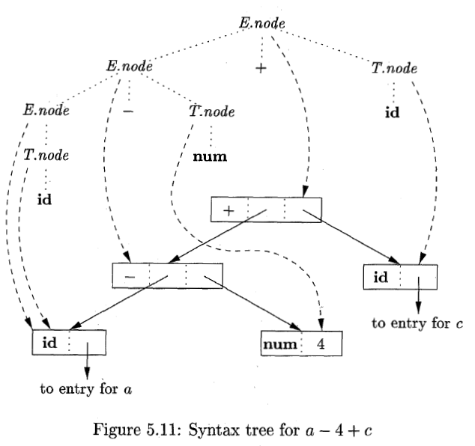
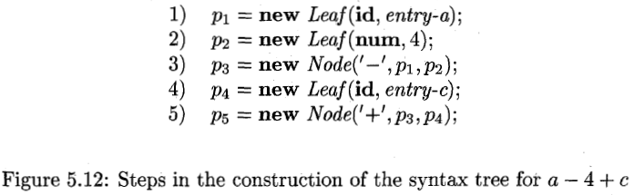
Construction of Syntax Trees
Example 5.11:
(continued)

Slide 29
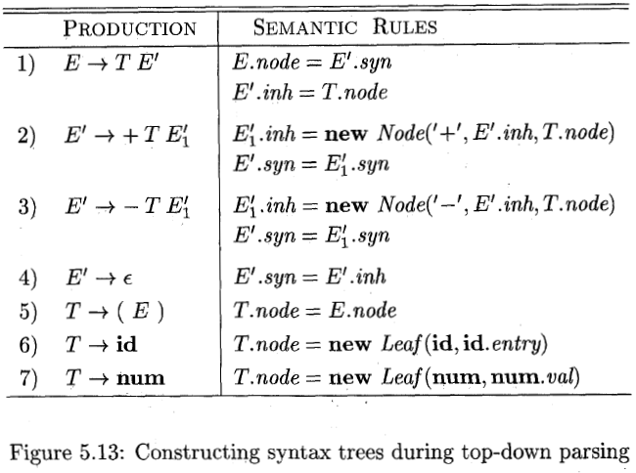
Construction of Syntax Trees
Syntax-Directed Translation

Slide 30
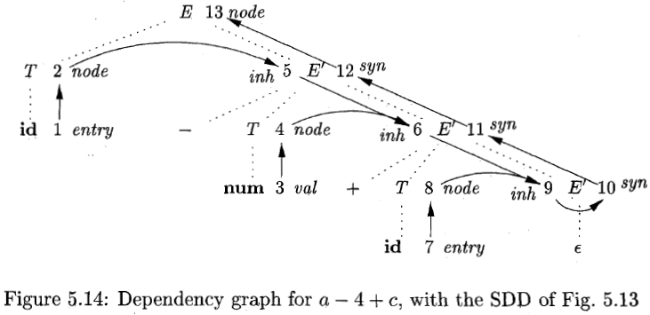
Construction of Syntax Trees
Syntax-Directed Translation

Slide 31
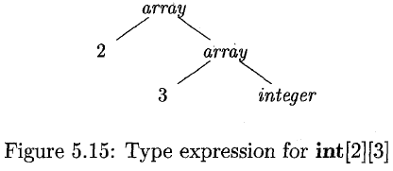
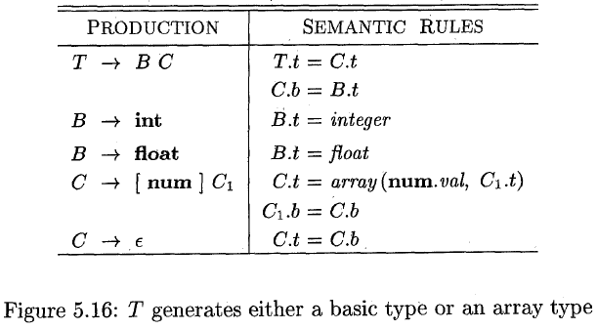
The Structure of a Type
Example 5.13:
Syntax-Directed Translation

Slide 32
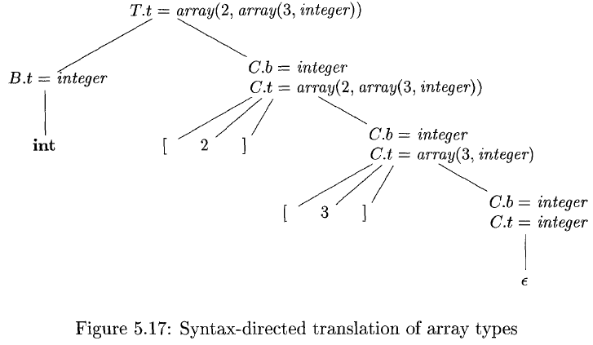
The Structure of a Type
Syntax-Directed Translation

Slide 33
Syntax-Directed Translation Schemes
Syntax-directed translation schemes are a complementary notation to SDDs.
All of the applications of SDDs can be implemented using SDT schemes.
Typically, SDTs are implemented during parsing, without building a parse tree.
We focus on the use of SDTs to implement two important classes of SDDs:
  The underlying grammar is LR-parsable, and the SDD is S-attributed.
  The underlying grammar is LL-parsable, and the SDD is L-attributed.
We shall see how the semantic rules in an SDD can be converted into an SDT with actions that are executed at the right time.
Syntax-Directed Translation

Slide 34
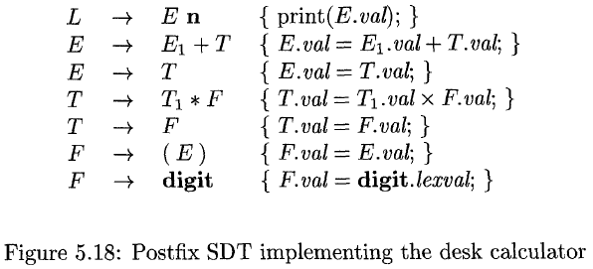
Postfix Translation Schemes
SDT’s with all actions at the right ends of the production bodies are called postfix SDT’s.
Example 5.14:
Syntax-Directed Translation

Slide 35
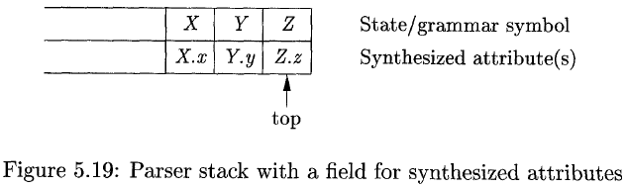
Parser-Stack Implementation of Postfix SDT’s
Postfix SDT’s can be implemented during LR parsing by executing the actions when reductions occur.
The attribute(s) of each grammar symbol can be put on the stack in a place where they can be found during the reduction.
Syntax-Directed Translation

Slide 36
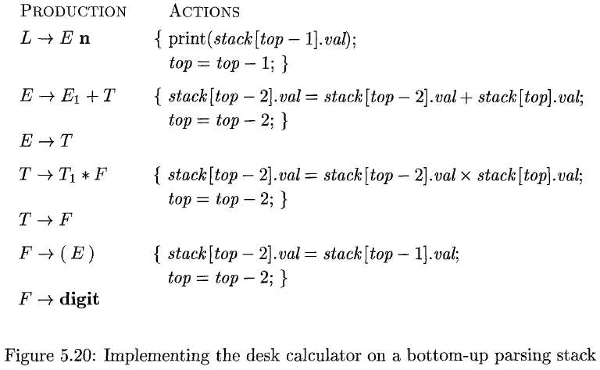
Parser-Stack Implementation of Postfix SDT’s
Example 5.15:
  Rewrite the actions of the desk-calculator so that they manipulate the parser stack explicitly.
Syntax-Directed Translation

Slide 37
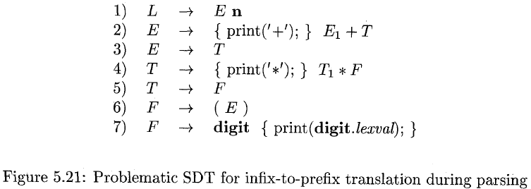
SDT’s With Actions Inside Productions
An action may be placed at any position within the body of a production.
It is performed immediately after all symbols to its left are processed.
Example 5.16:
  Turn the desk calculator running example into an SDT that prints the prefix form of an expression.
Syntax-Directed Translation

Slide 38
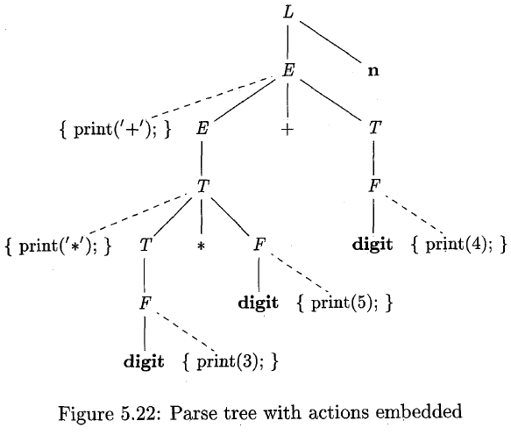
SDT’s With Actions Inside Productions
Syntax-Directed Translation

Slide 39
Eliminating Left Recursion from SDT’s
When transforming the grammar, treat the actions as if they were terminal symbols.
Example 5.17:
A → Aα | β
A → βR
R → αR | ε
E → E₁ + T {print(‘+’);}
E → T
E → T R
R → + T {print(‘+’);} R
R→ ε
Syntax-Directed Translation

Slide 40
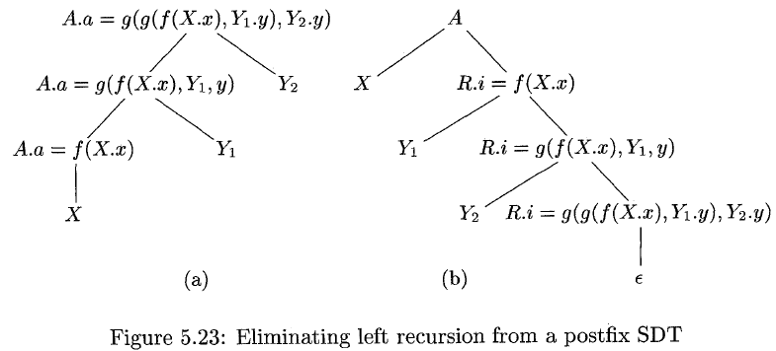
Eliminating Left Recursion from SDT’s
A → A₁ Y {A.a = g(A₁.a, Y.y)}
A → X { A.a = f(X.x)}
A → X R
R → Y R | ε
A → X {R.i = f(X.x)} R {A.a = R.s}
R → Y {R₁.i = g(R.i, Y.y} R₁ {R.s = R₁.s}
R → ε { R.s = R.i}
Syntax-Directed Translation

Slide 41
SDT’s for L-Attributed Definitions
The rules for turning an L-attributes SDD into an SDT are follows:
  Embed the action that computes the inherited attributes for a nonterminal A immediately before that occurrence of A in the body of the production. If several inherited attributes for A depend on one another in an acyclic fashion, order the evaluation of attributes so that those needed first are computed first.
  Place the actions that compute a synthesized attribute for the head of a production at the end of the body of the production.
Syntax-Directed Translation

Slide 42
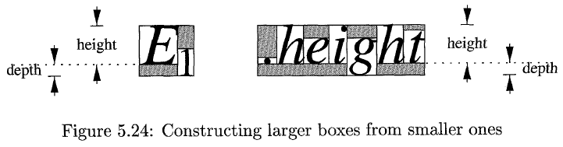
SDT’s for L-Attributed Definitions
Example 5.18:
  A simple grammar for boxes
  B → B₁ B₂ | B₁ sub B₂ | (B₁) | text
Syntax-Directed Translation

Slide 43
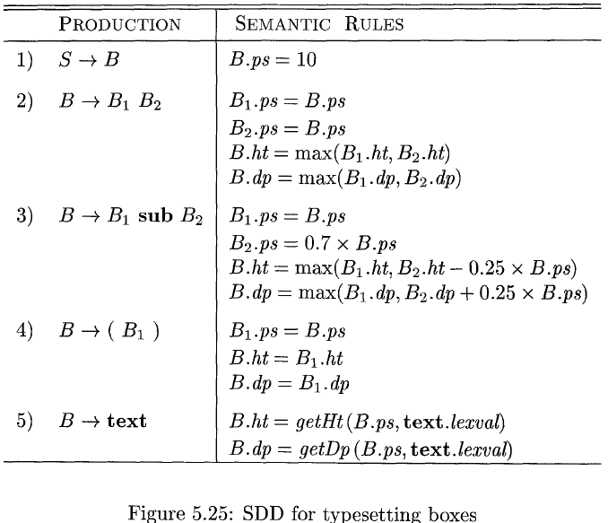
SDT’s for L-Attributed Definitions
Example 5.18: (continued)
Syntax-Directed Translation

Slide 44
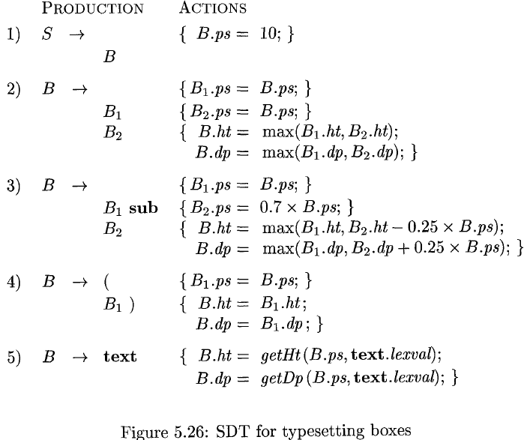
SDT’s for L-Attributed Definitions
Example 5.18: (continued)
Syntax-Directed Translation

Slide 45
THANK
YOU

